Slide 1
Features of geometric sequences
Task A: Identifying geometric sequences
1) Sort these sequences into geometric, arithmetic and ‘other’.
Geometric sequences
e) 1, 4, 16, 64, …
×4
×2
b) 1, 2, 4, 8, 16, …
k) 10, 20, 40, 80, 160, …
×2
×2
×10
d) −1, −2, −4, −8, −16, …
l) 10, 100, 1000, 10 000, …
+12
Arithmetic sequences
f) 4, 16, 28, 40, 52, …
a) 1, 2, 3, 4, 5, …
i) 10, 40, 70, 100, 130, …
+1
+30
Other sequences
c) 1, 2, 5, 10, 17, …
h) 10, 15, 20, 30, 40, …
+1
+3
+5
+7
+5
+5
+10
+10
g) 4, 16, 30, 46, 64, …
j) 10, 20, 60, 240, 1200, …
+12
+14
+16
+18
×2
×3
×4
×5

Slide 2
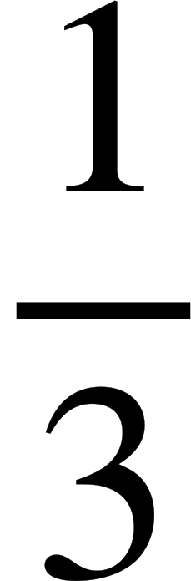
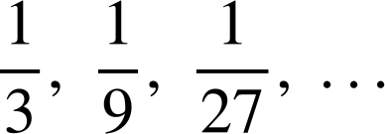





Features of geometric sequences
Task B: Generating geometric sequences
1) Generate the first five terms of these geometric sequences.
a) 1st term 1, common ratio of 3
1, 3, 9, 27, 81, …
b) 1st term 10, common ratio of 3
10, 30, 90, 270, 810, …
c) 1st term 5, ratio 1 : 3 between terms
5, 15, 45, 135, 405, …
d) 1st term 3, a ratio 1 : 5 between terms
3, 15, 75, 375, 1875, …
e) 1st term 64, a ratio 2 : 5 between terms
64, 160, 400, 1000, 2500, …
f) 1st term 81, common ratio of
81, 27, 9, 3, 1, …
g) 1st term 1875, a ratio 5 : 1 between terms
1875, 375, 75, 15, 3, …
h) 1st term 3, a ratio 3 : 1 between terms
3, 1,
2) Alex is generating these geometric sequences.
a) 1st term 216, common ratio
216, 72, 24, 8, …
b) 1st term 216, common ratio
216, 144, 96, 64, …
c) 1st term 216, common ratio
216, 324, 486, 729, …
Because these multipliers are fractions, all of these will be decreasing sequences.
Multiplier is greater than 1, therefore the sequence increases.
Show Alex that he is wrong.
Mathematics in Education and Industry.
v2.3

